Slide 1
Ride-Share Hub Application
By CSE_PROJ_2024_15

Slide 2
Created By
Rohan Jyoti Basu
Souvik Goswami
Subhangi Banerjee
Subhadeep Dey Sarkar
Under the guidance of
Ast. Prof. Satadal Chakraborty

Slide 3
Introduction
The Ride-Share Hub Application is a cutting-edge solution designed to simplify and optimize the process of ridesharing. By leveraging modern technology and user-friendly interfaces, it connects users seamlessly, revolutionizing the way people commute. This introduction sets the stage for an exploration of the app's features and benefits, highlighting its role in enhancing mobility and promoting sustainability.

Slide 4

Home Page
Welcome to the Ride-Share Hub
Welcome to the Ride-Share Hub, your gateway to hassle-free commuting and sustainable travel solutions. Our platform is designed to revolutionize the way you navigate your world, offering a seamless and convenient ridesharing experience.
With our intuitive interface and robust features, finding a ride or sharing your journey has never been easier. Whether you're heading to work, running errands, or exploring new destinations, Ride-Share Hub is your trusted companion for every trip.
Join our growing community of users today and embark on a journey towards smarter, greener, and more efficient transportation. Welcome aboard!

Slide 5
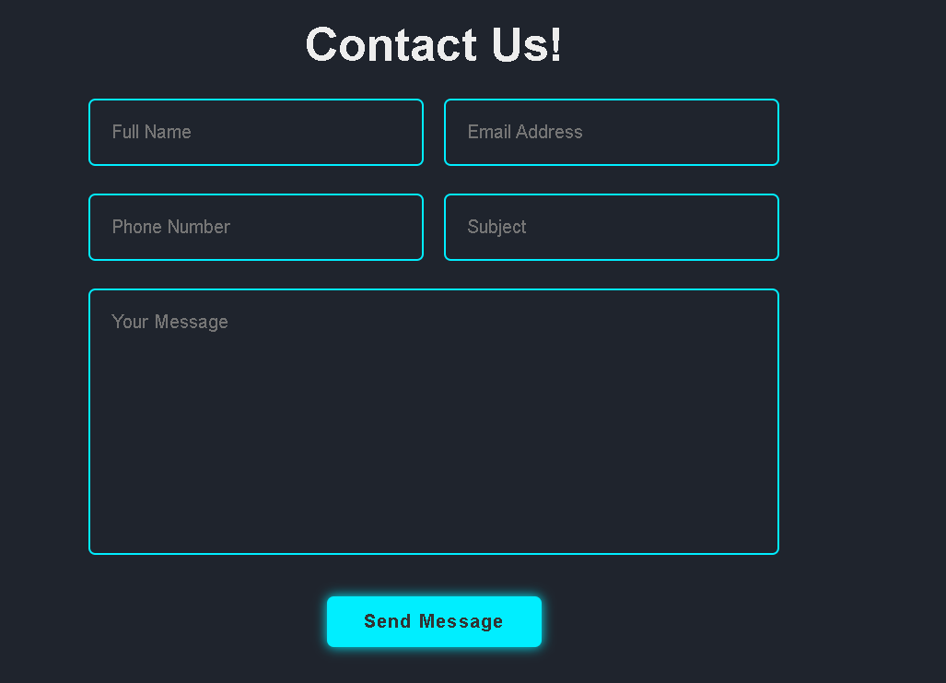
Contact Us Page
Our Contact Us page serves as a direct line of communication between users and our support team, facilitating efficient resolution of inquiries, feedback, and concerns. When users submit their details through this page, their information is securely stored in our database, ensuring a streamlined and organized approach to managing user interactions.
By harnessing the power of data-driven communication, we not only address user needs promptly but also gain valuable insights into user preferences and pain points. This enables us to continuously enhance our services and deliver a superior user experience tailored to our community's needs.
Experience the power of seamless communication with our Contact Us page, where every message matters, and every interaction counts.

Slide 6

Effortless Registration
Joining Ride-Share Hub is a breeze! Our registration page simplifies the process, requiring only essential information to get you started on your journey towards convenient and sustainable commuting.
Username: Choose a unique username that represents you on the platform, enabling easy identification and interaction with fellow users.
Email Address: Provide your email address to receive important updates, notifications, and communications regarding your Ride-Share Hub account.
Phone Number: Enter your phone number for verification and communication purposes, ensuring seamless coordination and connectivity with drivers and other users.
With just a few clicks, you'll be on your way to accessing a world of ridesharing opportunities and community-driven transportation solutions.

Slide 7
Privacy Policy
At Ride-Share Hub, we prioritize the security and confidentiality of your personal information. Our Privacy Policy outlines our commitment to safeguarding your data and ensuring compliance with privacy regulations.
Data Protection: We employ robust security measures to protect your information from unauthorized access, ensuring its confidentiality and integrity.
Information Collection: We collect only necessary data required for providing our services and improving user experience, maintaining transparency and accountability in our data practices.
Third-Party Disclosure: We do not sell, trade, or transfer your information to third parties without your consent, upholding your trust and privacy.
Cookie Usage: We utilize cookies to enhance user experience and track website analytics, adhering to industry best practices and user preferences.
Policy Updates: We periodically review and update our Privacy Policy to reflect changes in regulations and our business practices, ensuring ongoing compliance and transparency.
Your privacy matters to us. Explore our Privacy Policy to learn more about how we protect your information and uphold your rights as a user of Ride-Share Hub.

Slide 8
Safety Measures
At Ride-Share Hub, your safety is our top priority. We've implemented a range of safety measures to ensure your peace of mind throughout your ridesharing journey:
Driver Verification: All drivers undergo a thorough screening process, including background checks and vehicle inspections, to ensure they meet our safety standards.
User Ratings: Our rating system allows users to provide feedback and rate their rides, fostering accountability and transparency within the community.
Emergency Assistance: In case of emergencies, users have access to emergency assistance features, enabling them to quickly contact authorities or seek help from our support team.
Data Protection: We prioritize the security of your personal information, employing encryption and privacy measures to safeguard your data throughout your interactions with the platform.
Ride-Share Hub is committed to providing a safe and secure environment for all users, empowering you to enjoy the benefits of ridesharing with confidence.

Slide 9
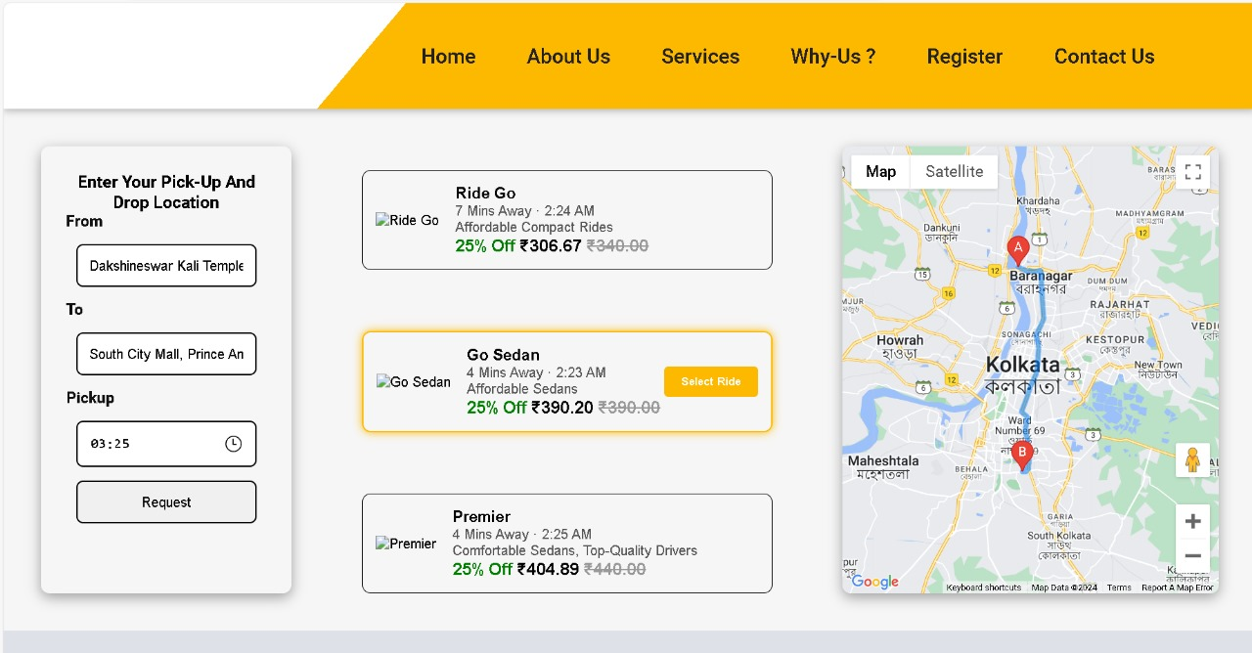
Map Feature
The Map page on Ride-Share Hub offers users a comprehensive view of available rides and pricing information, empowering them to make informed decisions about their journeys:
Real-Time Pricing: Users can view real-time pricing estimates for their desired routes, enabling them to plan their trips and budget accordingly.
Pickup and Drop Locations: The map displays pickup and drop locations, allowing users to visualize their routes and select the most convenient options for their commute.
Interactive Interface: With an intuitive and interactive interface, users can easily explore different routes, compare prices, and select the best ride options for their needs.
Experience the convenience of the Map feature on Ride-Share Hub, where every ride is just a click away.

Slide 10
Conclusion
In conclusion, Ride-Share Hub represents more than just a ridesharing platform; it's a catalyst for change in the way we commute and connect with our communities. With user-friendly interfaces, robust safety measures, and a commitment to sustainability, Ride-Share Hub is redefining transportation, empowering individuals to make smarter, greener choices for a brighter future.
As we navigate the ever-changing landscape of urban mobility, Ride-Share Hub remains steadfast in its mission to provide convenient, affordable, and sustainable transportation solutions for all. Join us on this journey towards a smarter, more connected world, where every ride is an opportunity to make a difference.
Thank you for choosing Ride-Share Hub. Together, we're transforming transportation, one ride at a time.

Slide 11
Thank You
.

